Slide 1

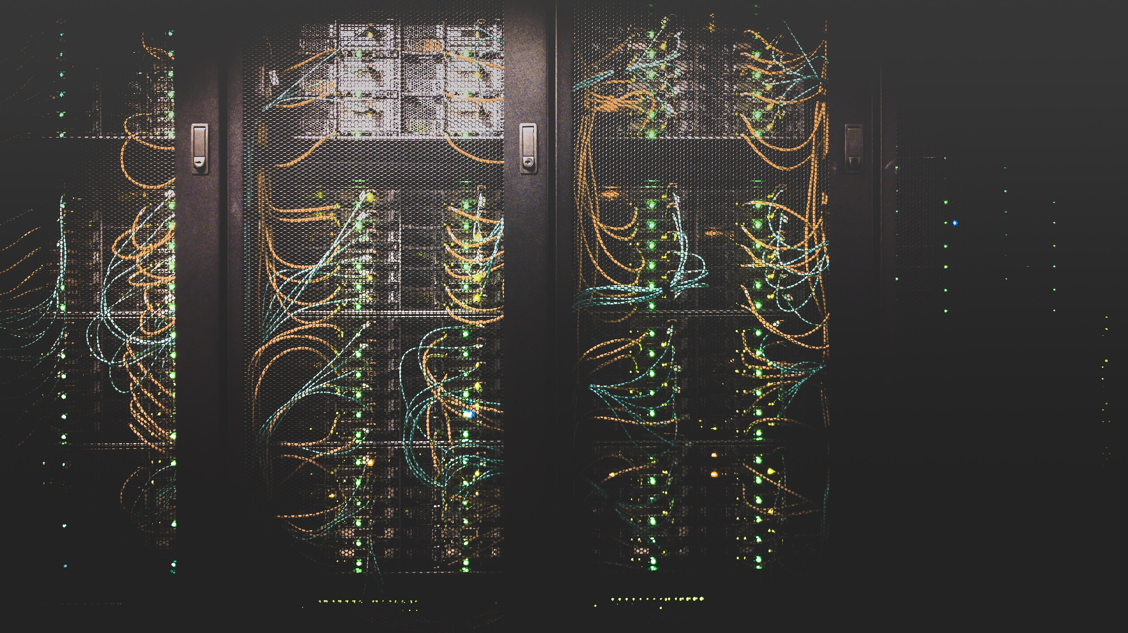
Cloud
Computing

Slide 2

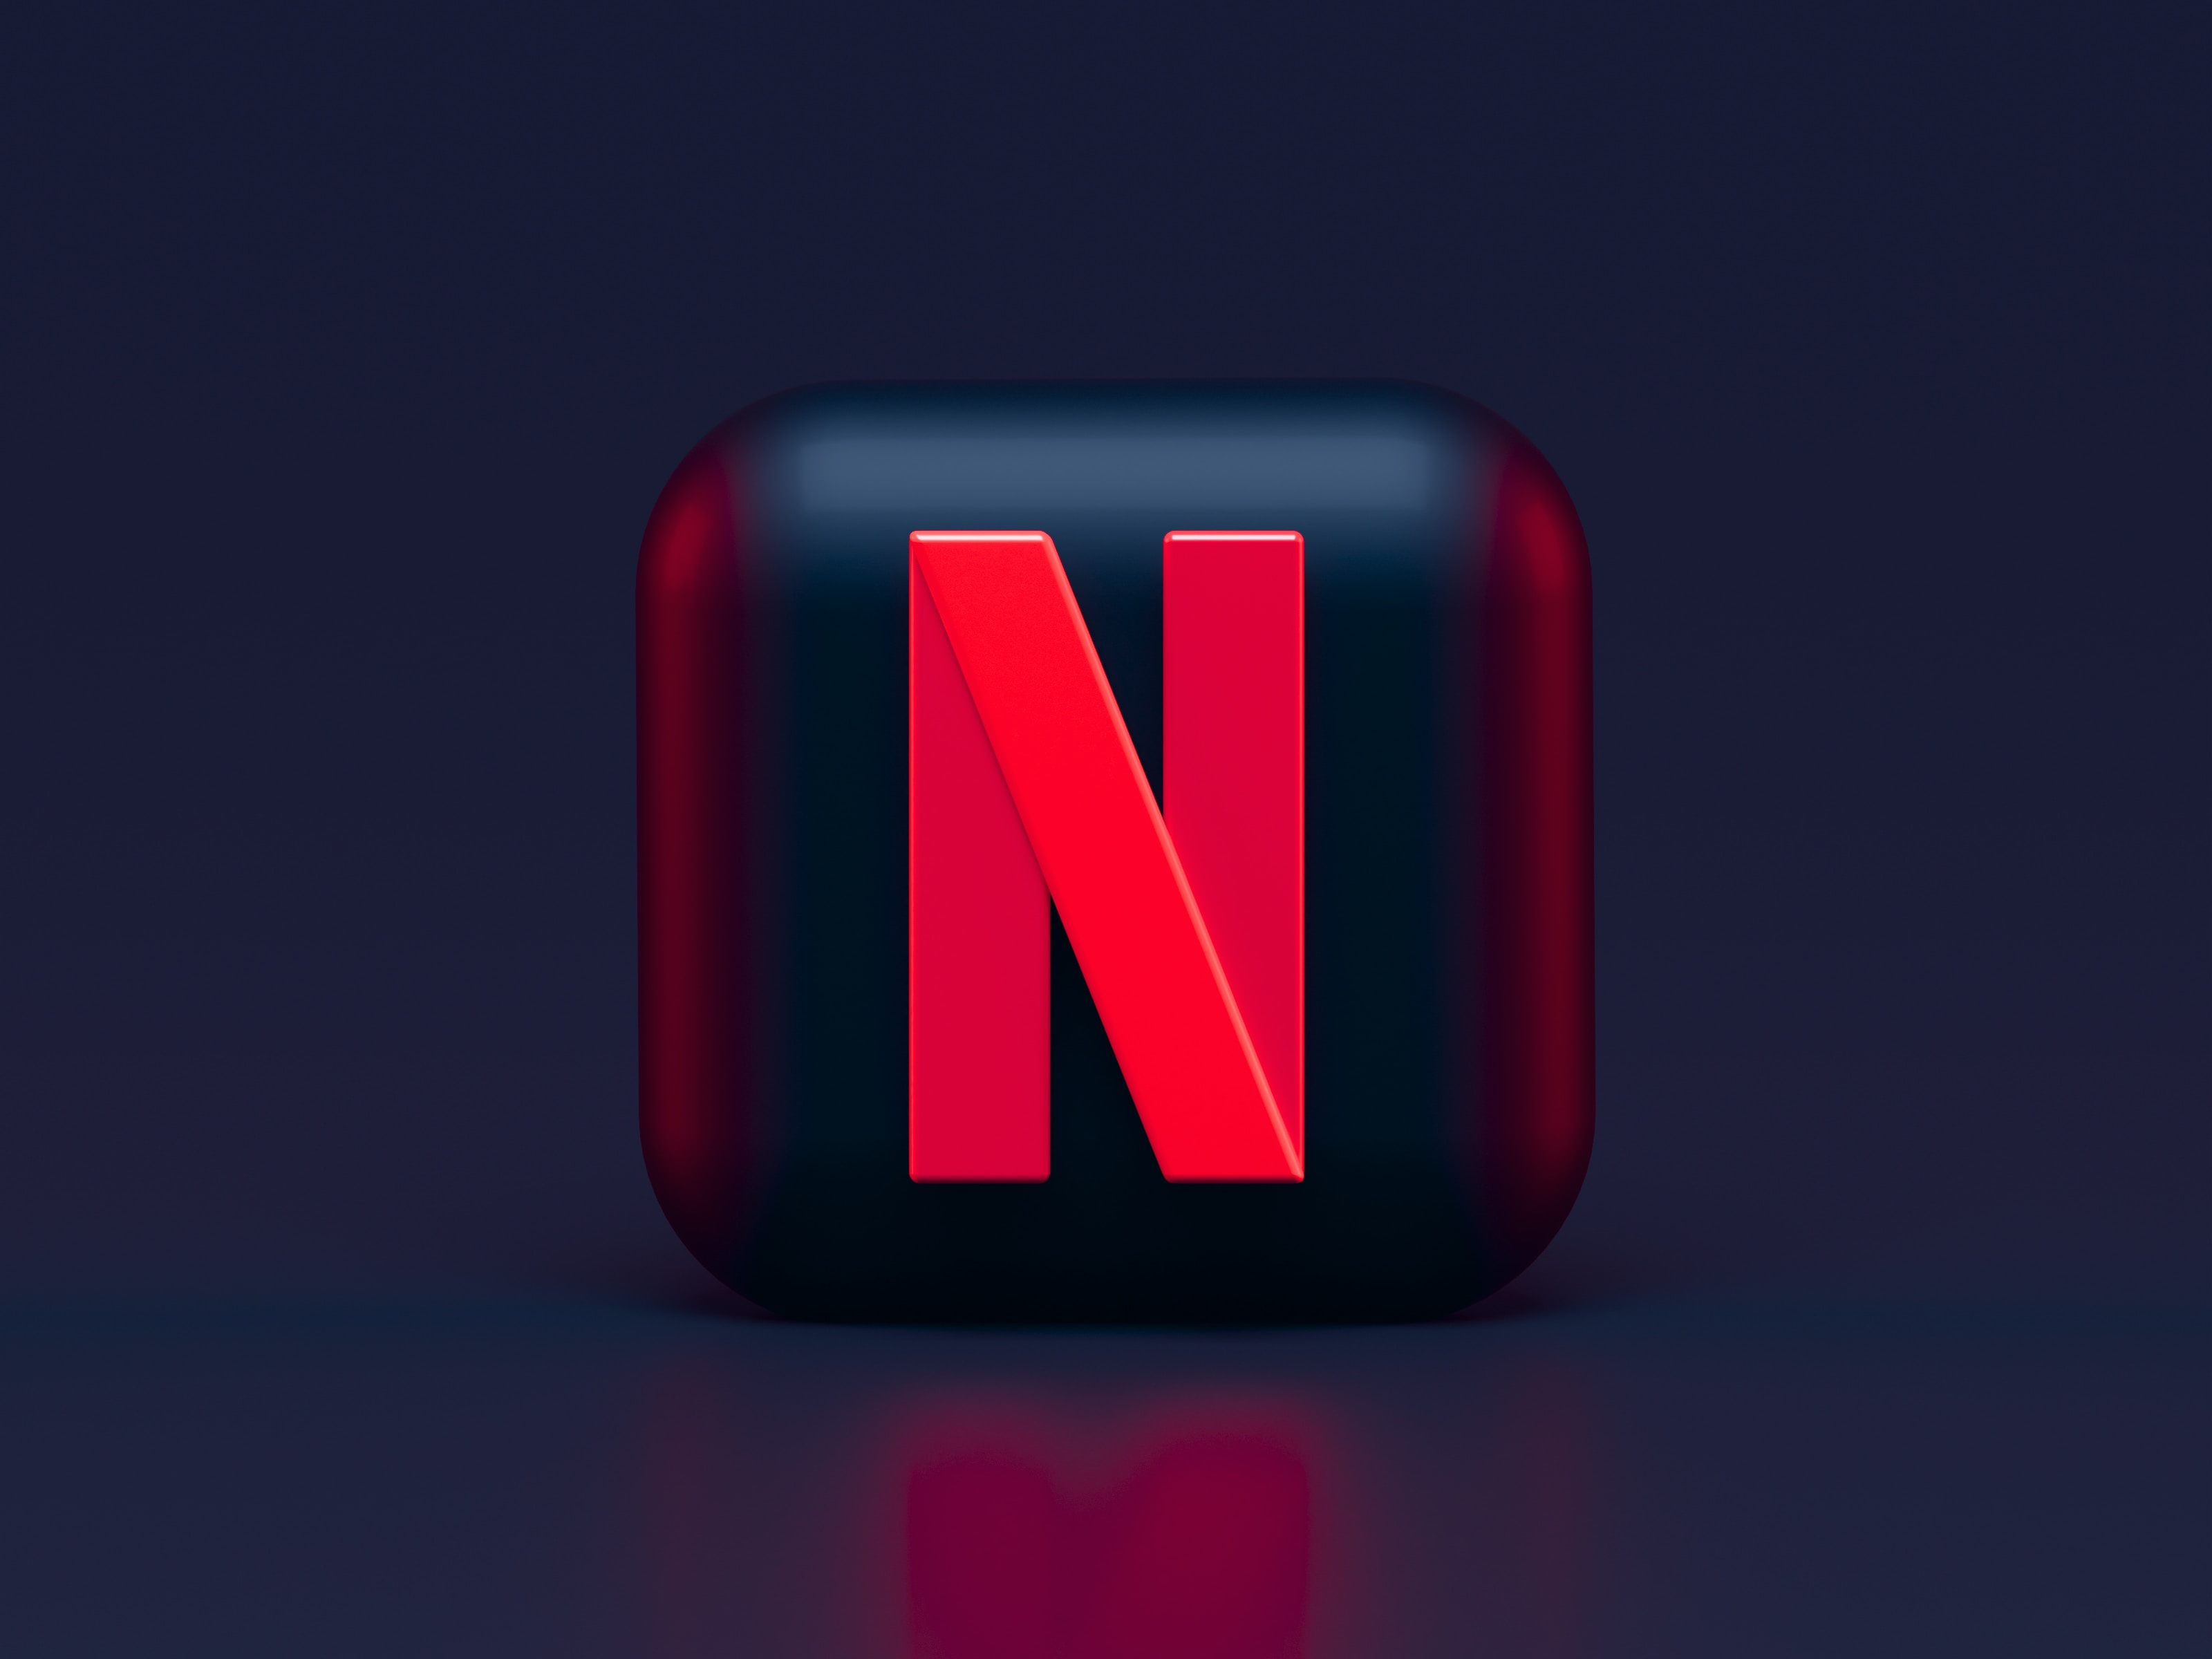

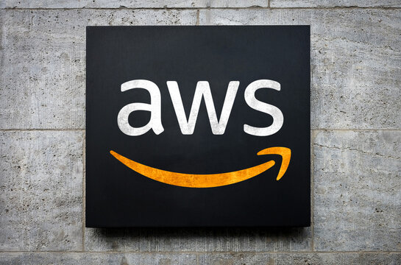
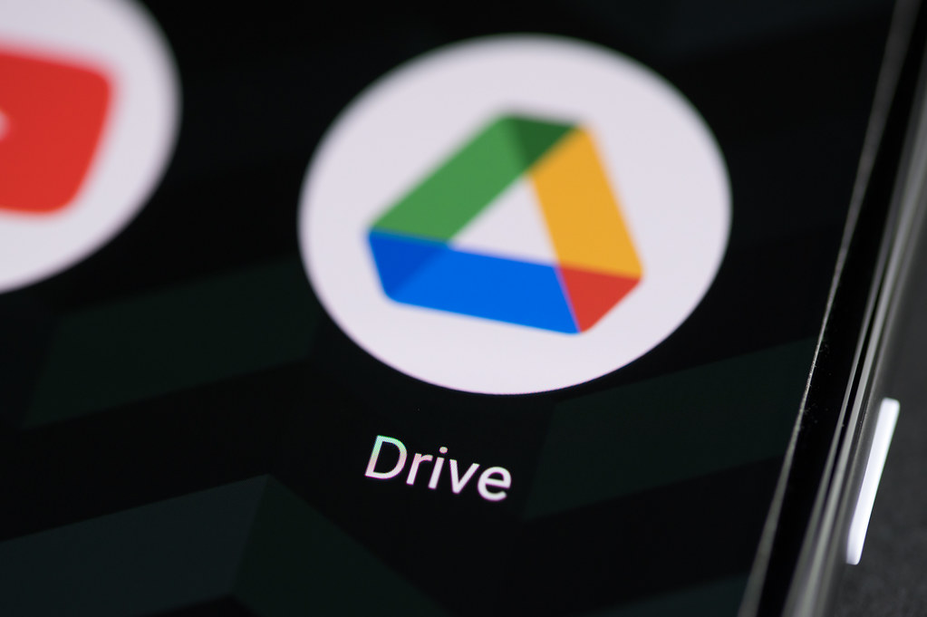
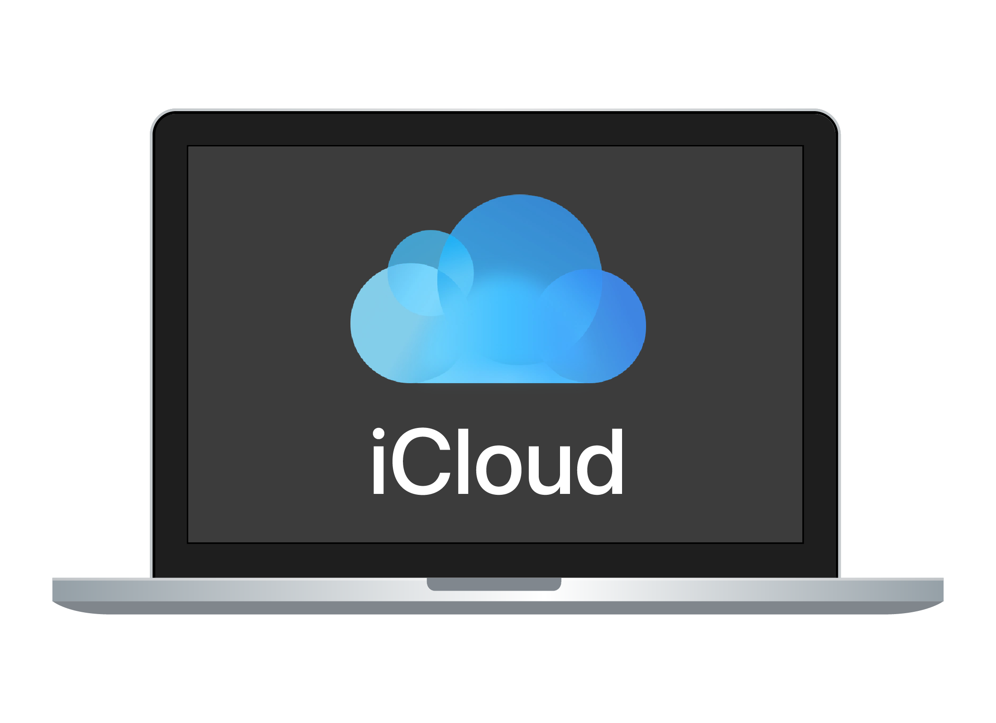
Cloud
Computing
Cloud Computing

Slide 3
EXAMPLES
Cloud Computing

Slide 4
EXAMPLES
Cloud Computing
Delivery
Availability
Analytics
Storage
Scalability
Personalization
Moderation

Slide 5
EXAMPLES
Delivery
Availability
Analytics
Cloud Computing
Storage
Scalability
Personalization
Moderation
Analytics
Redundancy
Critical
Recommendation

Slide 6
EXAMPLES
Storage
Scalability
Personalization
Moderation
Cloud Computing
Analytics
Redundancy
Critical
Recommendation
Storage
Accessibility
Scalability
Availability

Slide 7
EXAMPLES
Analytics
Redundancy
Critical
Recommendation
Cloud Computing
Storage
Accessibility
Scalability
Availability
Storage
Synchronization
Accessibility
Security

Slide 8
EXAMPLES
Storage
Accessibility
Scalability
Availability
Cloud Computing
Storage
Synchronization
Accessibility
Security
Services
Hosting
Scalability
Security
Personalization
Analytics
Foundation

Slide 9
EXAMPLES
Storage
Synchronization
Accessibility
Security
Cloud Computing
Services
Hosting
Scalability
Security
Personalization
Analytics
Foundation
Level Of Abstraction
Focus On Buisiness Logic

Slide 10
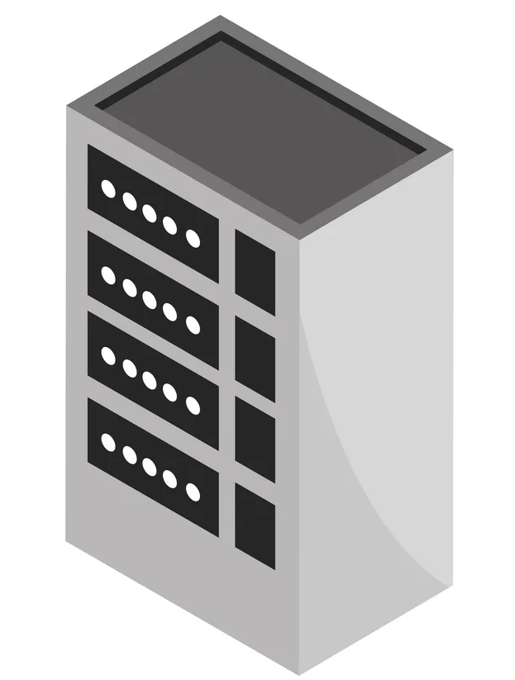
EXAMPLES
Services
Hosting
Scalability
Security
Personalization
Analytics
Foundation
Cloud Computing
Level Of Abstraction
Focus On Buisiness Logic

Slide 11
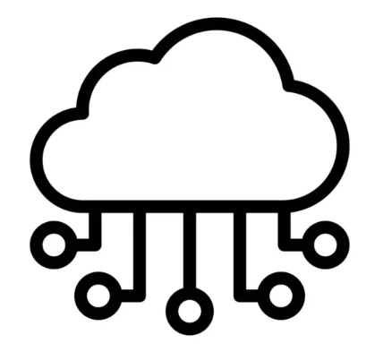

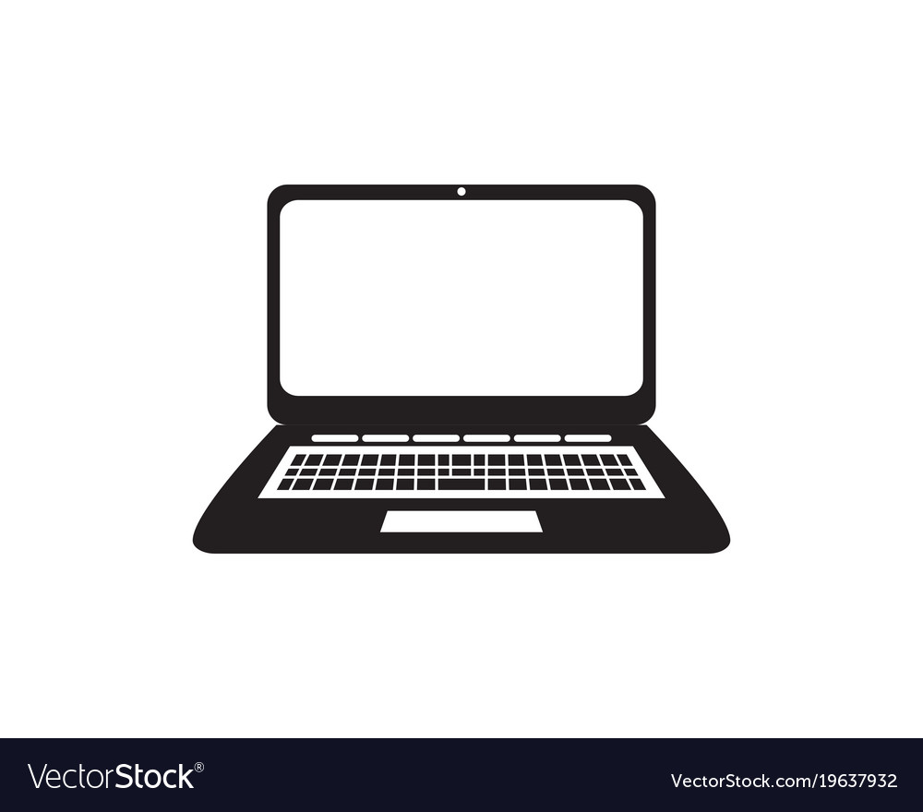
Cloud Computing
Severless
Containerization
Platform independence
More straightforward and faster deployments
Contanerization
Virtual Machines
Elastic Resources
Faster Provisioning
Level Of Abstraction
Virtual Machines
Physical Machines
Heavy Investment
Lives on Premises for years
Physical Machines
Severless
Event Driven
Pay per Use
Focus On Buisiness Logic

Slide 12
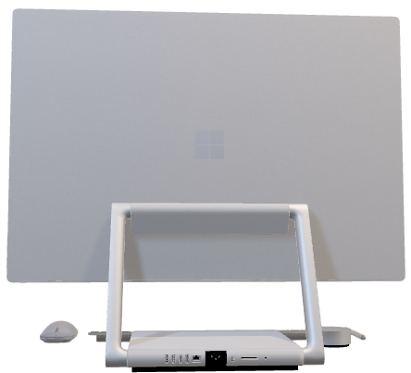
Cloud Computing
Let’s quickly understand what a computer is in it’s most basic sense!
"Cloud computing is the on-demand delivery of IT resources over the internet with pay-as-you-go pricing"
WHAT IS CLOUD COMPUTING ?
Consistent Delivery
On demand Accessibility
IT Resources
Level Of Abstraction
Focus On Buisiness Logic

Slide 13
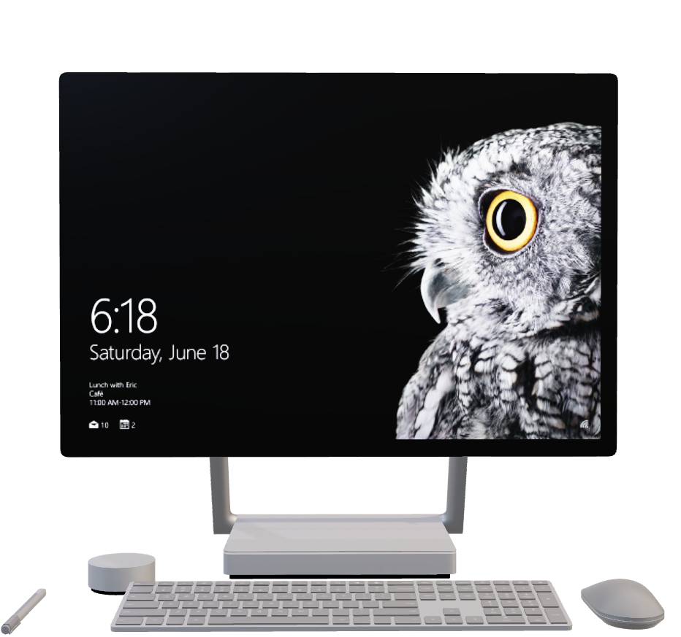
Cloud Computing
Let’s quickly understand what a computer is in it’s most basic sense!
Hardware:-
Processors ROM
RAM
GPU
PSU
"Cloud computing is the on-demand delivery of IT resources over the internet with pay-as-you-go pricing"

Slide 14
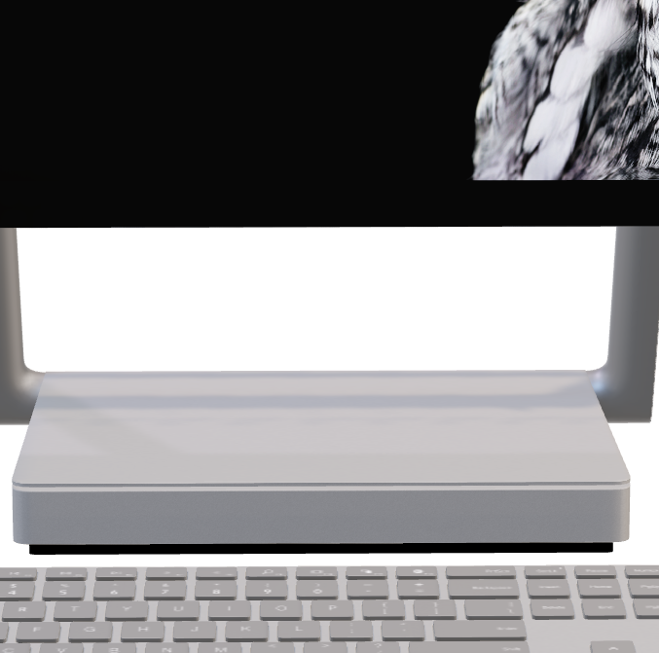
Cloud Computing
Hardware:-
Processors ROM
RAM
GPU
PSU
2) Operating System:-
Windows
Mac
Linux
Let’s quickly understand what a computer is in it’s most basic sense!

Slide 15
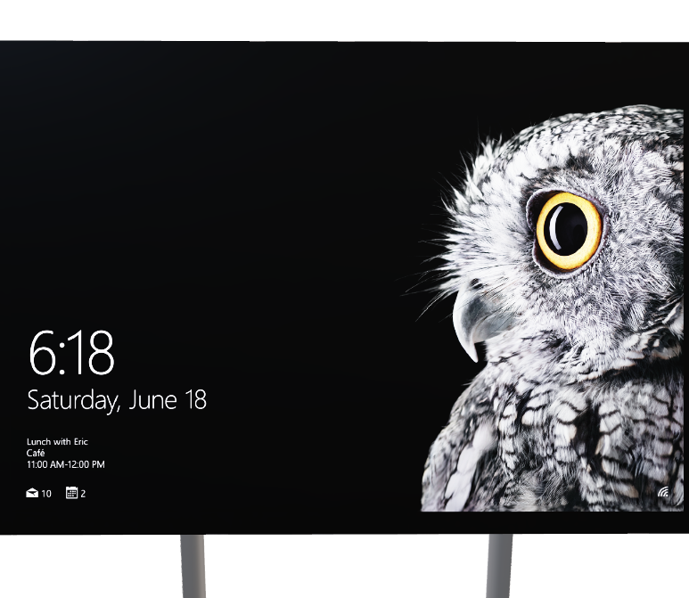
Cloud Computing
2) Operating System:-
Windows
Mac
Linux
3) Networking:-
Internet
All the Connectivity Drivers
Hardware:-
Processors ROM
RAM
GPU
PSU

Slide 16
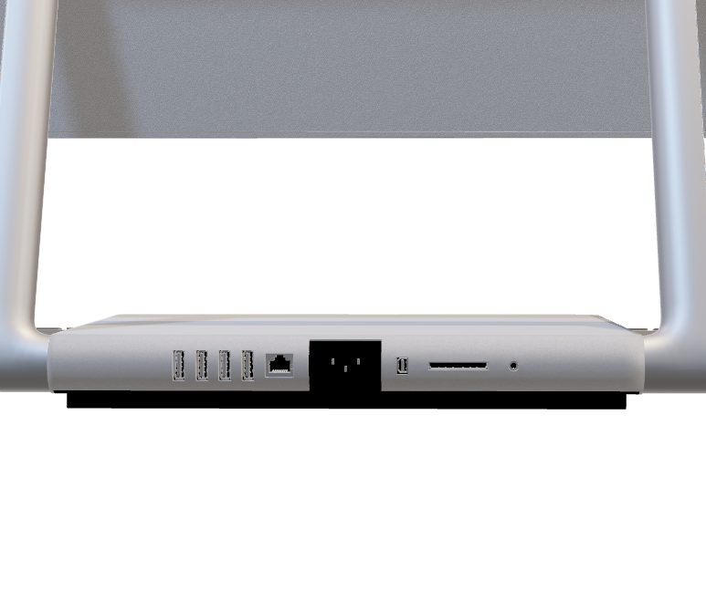
Cloud Computing
3) Networking:-
Internet
All the Connectivity Drivers
4) Storage:-
HDD
SSD
2) Operating System:-
Windows
Mac
Linux

Slide 17
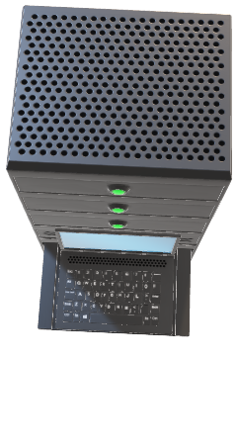
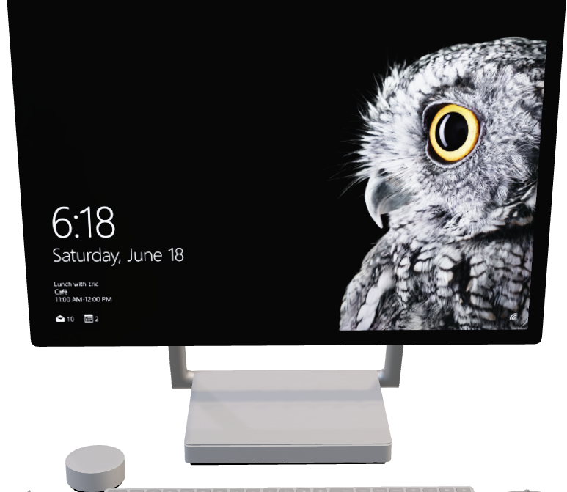
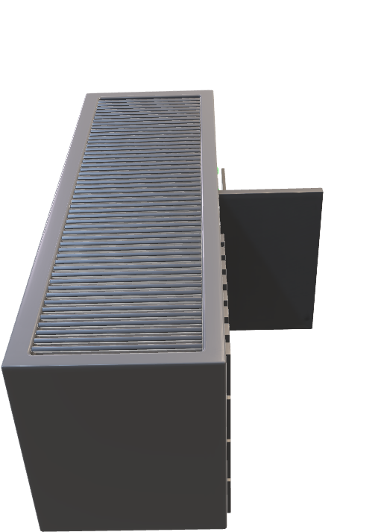
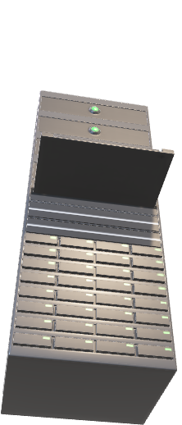
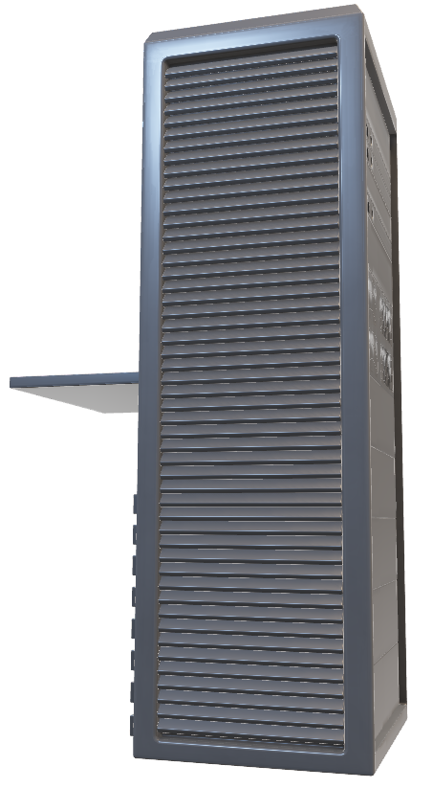
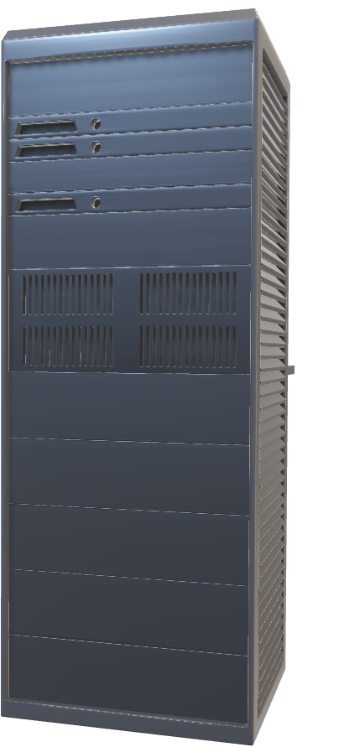
Cloud Computing
4) Storage:-
HDD
SSD
3) Networking:-
Internet
All the Connectivity Drivers
But, This is how a server room looks like in any cloud computing company,
so how exactly does even a single server caters to the need to many customers simultaneously?

Slide 18
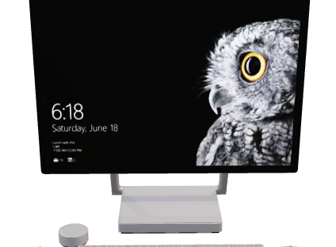
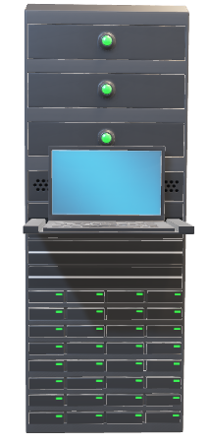
Cloud Computing
This is achieved by Virtualization
But, This is how a server room looks like in any cloud computing company,
so how exactly does even a single server caters to the need to many customers simultaneously?
4) Storage:-
HDD
SSD
Virtualization enables the creation of virtual machines (VMs), which are isolated and independent environments that mimic the functionality of a physical computer.
Each virtual machine operates as if it were a self-contained system, running its own operating system and applications.
Multiple virtual machines can coexist on a single physical server, allowing for more efficient use of hardware resources.

Slide 19
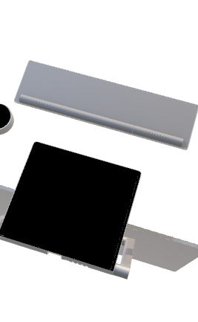

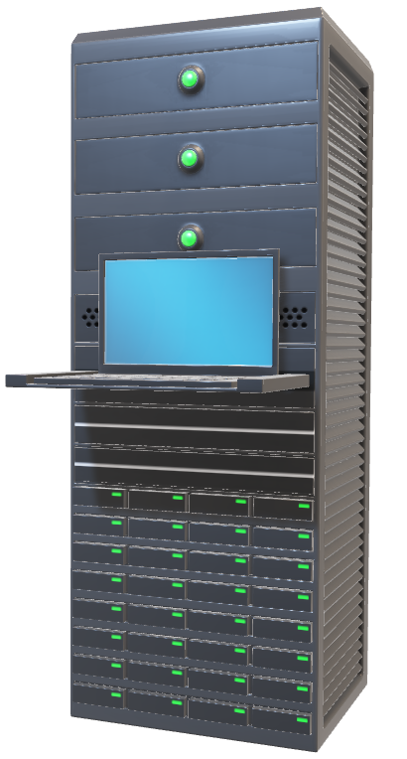
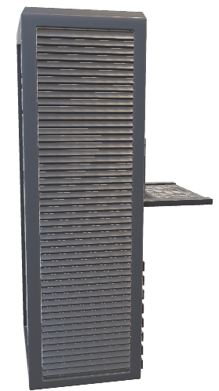
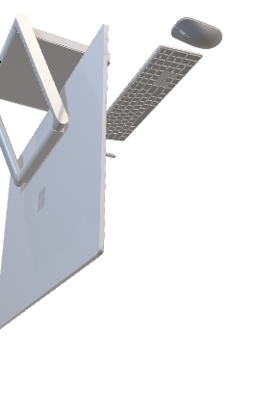
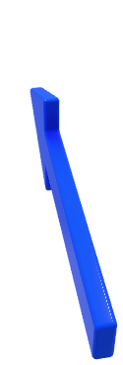
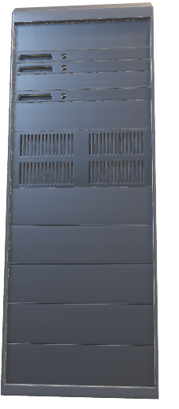
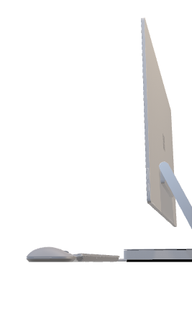
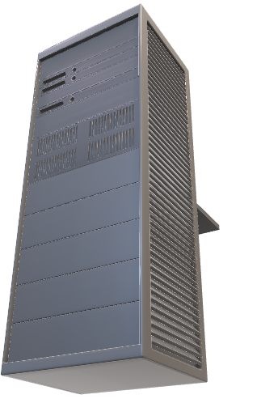

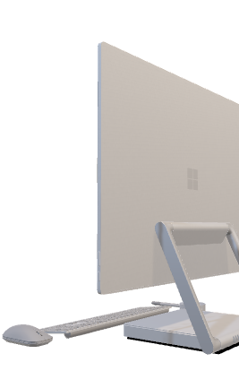
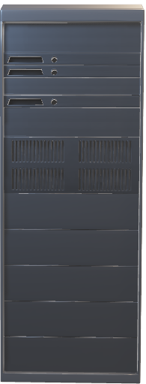
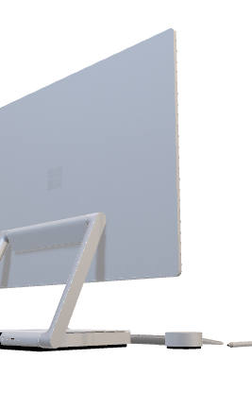
Cloud Computing
This is achieved by Virtualization
Virtualization enables the creation of virtual machines (VMs), which are isolated and independent environments that mimic the functionality of a physical computer.
Each virtual machine operates as if it were a self-contained system, running its own operating system and applications.
Multiple virtual machines can coexist on a single physical server, allowing for more efficient use of hardware resources.
But, This is how a server room looks like in any cloud computing company,
so how exactly does even a single server caters to the need to many customers simultaneously?

Slide 20
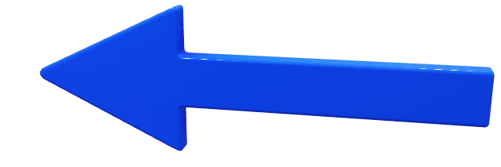
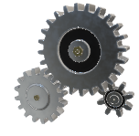
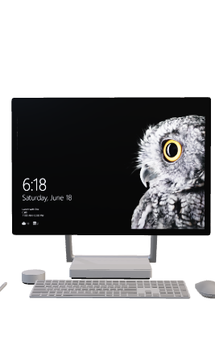

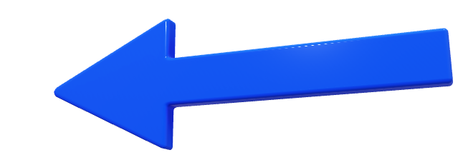
Cloud Computing
This is achieved by Virtualization
Virtualization enables the creation of virtual machines (VMs), which are isolated and independent environments that mimic the functionality of a physical computer.
Each virtual machine operates as if it were a self-contained system, running its own operating system and applications.
Multiple virtual machines can coexist on a single physical server, allowing for more efficient use of hardware resources.
Notes:
So What Exactly allows the server to be Distributed to multiple users as individual virtual machines?

Slide 21

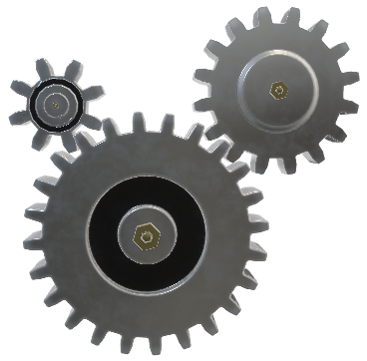

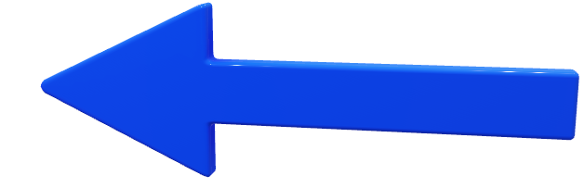
Cloud Computing
A hypervisor is like a special program that helps divide a big computer into smaller parts.
It sits between the physical hardware and the virtual machines (VMs).
The hypervisor's main job is to manage and allocate the hardware resources to each VM.
It creates virtual hardware and presents it to each VM, allowing them to run their own operating system and applications.
Each VM operates independently and securely, without interfering with other VMs.
The hypervisor acts like a manager, ensuring that each VM can use the computer's resources without causing problems for the others.
HYPERVISOR
Notes:
HYPERVISOR!!!

Slide 22
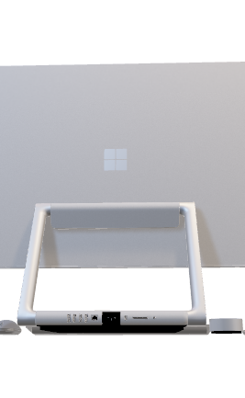

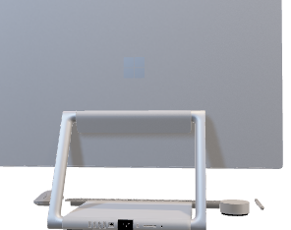
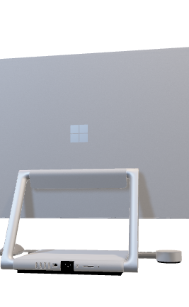

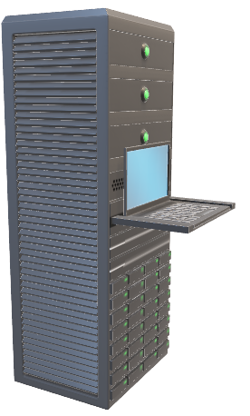
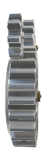
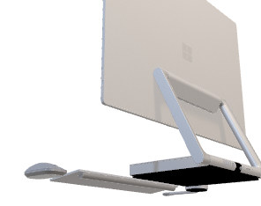
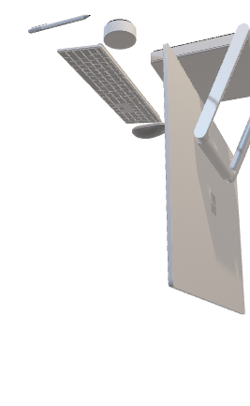
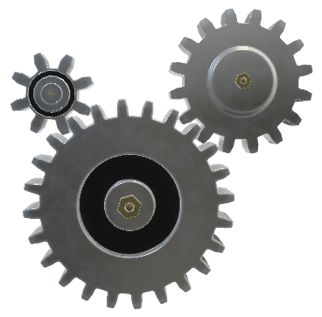
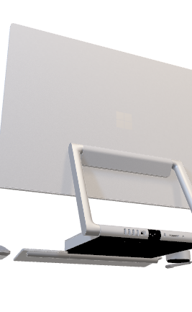

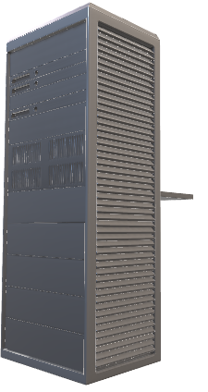
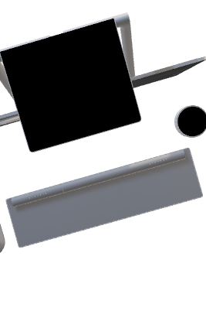
Cloud Computing
HYPERVISOR
Type 1 or Bare-metal Hypervisor:
Runs directly on the physical hardware.
Installed directly on the server hardware.
Manages the virtual machines.
Provides high performance and efficiency.
Has direct access to the hardware resources.
Type 2 or Hosted Hypervisor:
Runs on top of an existing operating system.
Installed as software applications on a host operating system.
Creates virtual machines within that operating system.
Typically used in desktop or workstation environments.
Used for individual users' virtualization needs.
A hypervisor is like a special program that helps divide a big computer into smaller parts.
It sits between the physical hardware and the virtual machines (VMs).
The hypervisor's main job is to manage and allocate the hardware resources to each VM.
It creates virtual hardware and presents it to each VM, allowing them to run their own operating system and applications.
Each VM operates independently and securely, without interfering with other VMs.
The hypervisor acts like a manager, ensuring that each VM can use the computer's resources without causing problems for the others.
Notes:
A hypervisor is like a special software or program that helps divide a big computer into smaller parts, almost like having many computers inside one. It sits between the real physical parts of the computer and the virtual parts that the smaller computers use.
The main job of a hypervisor is to make sure each small computer, called a virtual machine, can use the physical parts of the computer without causing problems for the others. It does this by pretending to be the physical parts and giving each virtual machine its own virtual parts to use.
With the help of a hypervisor, each virtual machine can run its own operating system and programs, just like it has its own separate computer. The hypervisor makes sure that what one virtual machine does doesn't affect the others, so they can all work independently and securely.
In simple words, a hypervisor is like a manager that helps many virtual machines share a computer without getting in each other's way. It keeps things organized and makes sure each virtual machine can do its own tasks without causing trouble for the others.

Slide 23
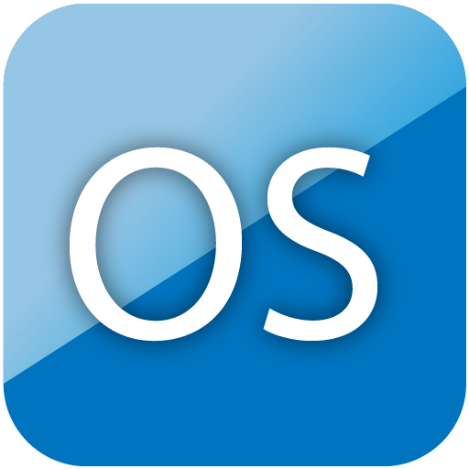



Cloud Computing
HYPERVISOR
Type 1 or Bare-metal Hypervisor:
Runs directly on the physical hardware.
Installed directly on the server hardware.
Manages the virtual machines.
Provides high performance and efficiency.
Has direct access to the hardware resources.
Notes:
Type 1 or Bare-metal Hypervisor: This type of hypervisor runs directly on the physical hardware without the need for an underlying operating system. It is installed directly on the server hardware and manages the virtual machines. Type 1 hypervisors provide high performance and efficiency since they have direct access to the hardware resources.

Slide 24




Cloud Computing
HYPERVISOR
Type 2 or Hosted Hypervisor:
Runs on top of an existing operating system.
Installed as software applications on a host operating system.
Creates virtual machines within that operating system.
Typically used in desktop or workstation environments.
Used for individual users' virtualization needs.
Public Cloud
Public cloud is a deployment model where third-party service providers offer computing resources over the internet.
Applications and data are hosted on the provider's infrastructure.
It is accessible remotely and on a pay-per-use basis.
Scalability, maintenance, and security are handled by the provider.
Examples include AWS, Azure, and GCP.
Notes:
Type 2 or Hosted Hypervisor: Type 2 hypervisors run on top of an existing operating system. They are installed as software applications on a host operating system and create virtual machines within that operating system. Type 2 hypervisors are typically used in desktop or workstation environments where virtualization is needed for individual users.

Slide 25




Cloud Computing
DEPLOYMENT MODELS
2. Private Cloud
Private cloud is a dedicated deployment model for a single organization.
It offers exclusive control, enhanced security, and privacy.
Can be hosted on-premises or managed by a third-party.
Provides customization, resource allocation, and configurations.
Ideal for organizations with strict data security and compliance needs.
Offers predictable performance and reliability.
Maintenance, management, and security are the organization's responsibility.
Examples: VMware vSphere, OpenStack, Azure Stack.
Public Cloud
Public cloud is a deployment model where third-party service providers offer computing resources over the internet.
Applications and data are hosted on the provider's infrastructure.
It is accessible remotely and on a pay-per-use basis.
Scalability, maintenance, and security are handled by the provider.
Examples include AWS, Azure, and GCP.
Notes:
Service Models Software as a Service
Platform as a Service
Infrastructure as a Service

Slide 26
Cloud Computing
DEPLOYMENT MODELS
3. Hybrid Cloud
Hybrid cloud combines public and private cloud infrastructure.
It allows organizations to use both on-premises and public cloud services.
Data and applications can move seamlessly between the private and public cloud.
It offers flexibility for workload placement based on security, compliance, and performance needs.
Organizations can benefit from public cloud scalability while maintaining control over sensitive data.
Hybrid cloud requires managing both public and private cloud resources.
Examples: AWS Outposts, Azure Stack, Google Anthos.
Hybrid cloud is popular for businesses with specific data privacy or regulatory requirements.
2. Private Cloud
Private cloud is a dedicated deployment model for a single organization.
It offers exclusive control, enhanced security, and privacy.
Can be hosted on-premises or managed by a third-party.
Provides customization, resource allocation, and configurations.
Ideal for organizations with strict data security and compliance needs.
Offers predictable performance and reliability.
Maintenance, management, and security are the organization's responsibility.
Examples: VMware vSphere, OpenStack, Azure Stack.
Public Cloud
Public cloud is a deployment model where third-party service providers offer computing resources over the internet.
Applications and data are hosted on the provider's infrastructure.
It is accessible remotely and on a pay-per-use basis.
Scalability, maintenance, and security are handled by the provider.
Examples include AWS, Azure, and GCP.
Notes:
Service Models Software as a Service
Platform as a Service
Infrastructure as a Service

Slide 27

Cloud Computing
DEPLOYMENT MODELS
2. Private Cloud
Private cloud is a dedicated deployment model for a single organization.
It offers exclusive control, enhanced security, and privacy.
Can be hosted on-premises or managed by a third-party.
Provides customization, resource allocation, and configurations.
Ideal for organizations with strict data security and compliance needs.
Offers predictable performance and reliability.
Maintenance, management, and security are the organization's responsibility.
Examples: VMware vSphere, OpenStack, Azure Stack.
3. Hybrid Cloud
Hybrid cloud combines public and private cloud infrastructure.
It allows organizations to use both on-premises and public cloud services.
Data and applications can move seamlessly between the private and public cloud.
It offers flexibility for workload placement based on security, compliance, and performance needs.
Organizations can benefit from public cloud scalability while maintaining control over sensitive data.
Hybrid cloud requires managing both public and private cloud resources.
Examples: AWS Outposts, Azure Stack, Google Anthos.
Hybrid cloud is popular for businesses with specific data privacy or regulatory requirements.
Notes:
Service Models Software as a Service
Platform as a Service
Infrastructure as a Service

Slide 28
SaaS (Software as a Service): Software applications provided over the internet, accessible through a web browser or API. Example: Gmail, a widely used SaaS-based email service provided by Google.
PaaS (Platform as a Service): Platform and development tools offered as a service, allowing developers to build, deploy, and manage applications. Example: Google Colab, a PaaS platform that provides an online development environment for coding, data analysis, and machine learning.
IaaS (Infrastructure as a Service): Virtualized computing resources, such as servers, storage, and networking, provided as a service. Example: Amazon Web Services (AWS), a leading IaaS provider offering a range of virtualized infrastructure resources for businesses in India.
Cloud Computing
SERVICE MODELS
Notes:
Service Models Software as a Service
Platform as a Service
Infrastructure as a Service

Slide 29

Cloud Computing
SERVICE MODELS
SaaS (Software as a Service): Software applications provided over the internet, accessible through a web browser or API. Example: Gmail, a widely used SaaS-based email service provided by Google.
PaaS (Platform as a Service): Platform and development tools offered as a service, allowing developers to build, deploy, and manage applications. Example: Google Colab, a PaaS platform that provides an online development environment for coding, data analysis, and machine learning.
IaaS (Infrastructure as a Service): Virtualized computing resources, such as servers, storage, and networking, provided as a service. Example: Amazon Web Services (AWS), a leading IaaS provider offering a range of virtualized infrastructure resources for businesses in India.
Notes:
Service Models Software as a Service
Platform as a Service
Infrastructure as a Service

Slide 30

Cloud Computing
SERVICE MODELS
SaaS (Software as a Service): Software applications provided over the internet, accessible through a web browser or API. Example: Gmail, a widely used SaaS-based email service provided by Google.
PaaS (Platform as a Service): Platform and development tools offered as a service, allowing developers to build, deploy, and manage applications. Example: Google Colab, a PaaS platform that provides an online development environment for coding, data analysis, and machine learning.
IaaS (Infrastructure as a Service): Virtualized computing resources, such as servers, storage, and networking, provided as a service. Example: Amazon Web Services (AWS), a leading IaaS provider offering a range of virtualized infrastructure resources for businesses in India.
Notes:
https://tutorialsdojo.com/what-is-cloud-computing/ helpful resource

Slide 31
Cloud Computing
SERVICE MODELS
Notes:
https://tutorialsdojo.com/what-is-cloud-computing/ helpful resource

